Slide 1
Educational Technology
Mr. Galusha

Slide 2
Module 3: Preparing to Plan Agenda
Activator: The unprepared teacher
An introduction to lesson plans and writing behavioral objectives
Activity: Assignment 2 - How to create a lesson plan template you can use.
Summarizer: How to use your lesson plan template
HW:
Complete Assignment 2
Post and review a resource on our Facebook page
Notes:
2

Slide 3
The unprepared teacher
10th grade class out of control
Kindergarten class out of control
Classroom Management Tips
Notes:
3

Slide 4
Classroom Management
Daily Preparation
Attitude
Classroom Expectations

Slide 5
The first year is not easy
180 days
540 to 1080 lessons over the course of your first year
If each lesson takes a 30 to 45 minutes to write, then you are talking 500 hours of lesson planning.
That’s 20 days of round the clock planning
That’s 12.5 hours of lesson planning a week during your first year.
Planning is your new part-time job
And we haven’t even started talking about the correcting!
If we can save you just 5 minutes each lesson plan, we can shave 66 hours ( or 2.75 days) off of that lesson planning time during your first year.

Slide 6
Save time by getting good at the basics
Have clear objectives
Use a lesson plan template

Slide 7
Writing instructional objectives
1. Activity (a statement that describes the conditions under which the behavior is to be performed)
2. Behavioral Verb (an action word that denotes an observable student behavior)
3. Criteria (a statement that specifies how well the student must perform the behavior).

Slide 8
Writing instructional objectives
Activity (a statement that describes the conditions under which the behavior is to be performed)
Upon request the student will (this means the student is given an oral or written request to do something).
Given (some physical object) the student will (this means the student is actually given something that relates to performing the intended behavior).

Slide 9
Writing instructional objectives
2. Behavioral Verb (an action word that denotes an observable student behavior)
The verb in an instructional objective is an action word that connotes an observable behavior.
Classify Diagram
Compose Estimate
Construct Identify
Define Locate
Demonstrate Predict
Describe Solve

Slide 10
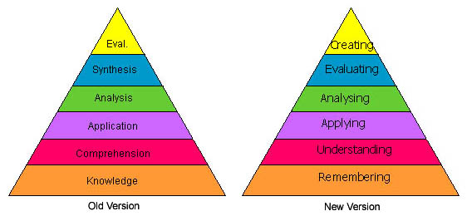

Slide 11
Writing instructional objectives
3. Criteria (a statement that specifies how well the student must perform the behavior).
USE THE STANDARDS AS YOUR BENCHMARK!!!
Given a list of the first 100 numbers arranged in ascending order(conditions), the student will identify (verb) at least nine prime numbers (criteria).

Slide 12
Writing instructional objectives
Given Assignment 2 students will produce a fully automated lesson plan template.

Slide 13
Writing instructional objectives
Given (activity) students
will __(behavioral verb)__ _(criteria)_______

Slide 14
Save time by getting good at the basics
Have clear objectives
Use a lesson plan template

Slide 15
.Docx vs. Dotx
When you open a document in Word and save it the default extension is .docx.
A template is a document type that creates a copy of itself when you open it. In Microsoft Office Word 2007, you can create a template saving a document as a .dotx file

